Slide 1

Online Delivery Operations

Slide 2





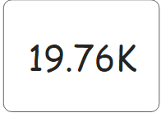
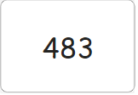
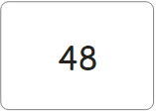
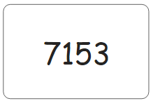
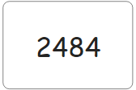
Introduction and Summary

Slide 3
Key Result Areas
Pickers & Tote
Customers
Product

Slide 4
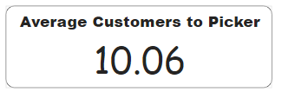



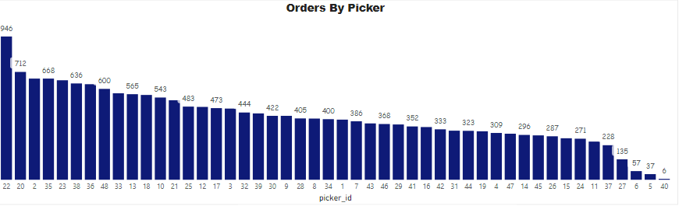
Pickers and Tote Measures

Slide 5
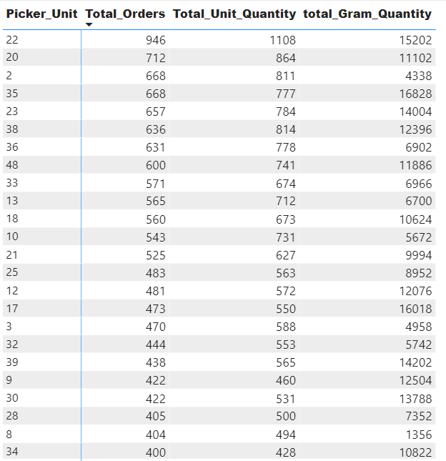
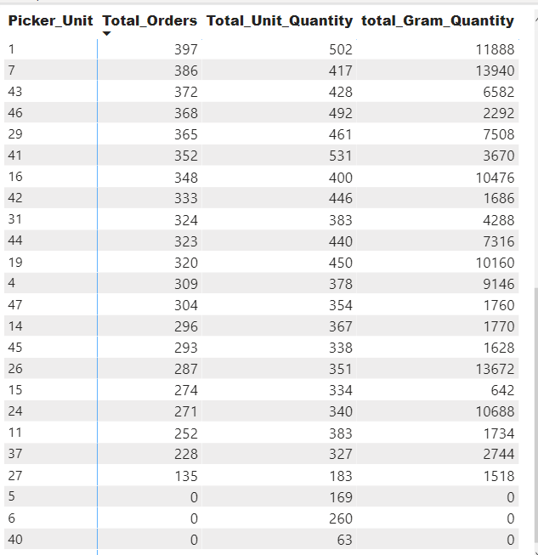
Pickers Drill Down

Slide 6
Picker and Tote Measures – SQL Syntax
--Number Customer
select count (distinct order_number) from Picking_Data
---Number of Pickers
Select count (distinct picker_id) from Picking_Data
--Average Picker To customer =
Select count(distinct order_number)/count (distinct picker_id) as Average_Picker_Per_customer from Picking_Data
--Average numbers of orders per picker
Select count(order_number)/count (distinct picker_id) as Average_Picker_per_order from Picking_Data
-- tote to customer ratio
select count (distinct tote_number) as No_of_tote, count(distinct Order_Number) as No_of_Customer,
count(distinct tote_number)/count(distinct Order_Number) Tote_Per_Customer from Picking_Data
-- tote to orders ratio
select count (distinct tote_number) as No_of_tote, count(Order_Number) as No_of_Customer,
count(Order_Number)/count(distinct tote_number) Tote_Per_Customer from Picking_Data

Slide 7
Picker and Tote Measures – SQL Syntax
with AA as
(
Select picker_id, count(order_number) as Total_Order, sum(QTY) as Total_Qty from Picking_Data
where PICKED_UNIT_OF_MEASURE = 'each'
group by picker_id),
AB as
(Select picker_id, count(order_number) as Total_Order, sum(QTY) as Total_Qty from Picking_Data
where PICKED_UNIT_OF_MEASURE = 'gram'
group by picker_id),
AC as(
Select AB.picker_id as Picker_Unit, isnull(AA.Total_Order + AB.Total_Order,0) as Total_Orders, AA.Total_Qty as Total_Unit_Quantity, isnull(AB.Total_Qty,0) as total_Gram_Quantity
From AA left join AB
On AA.picker_id = AB.picker_id)
Select * from AC

Slide 8


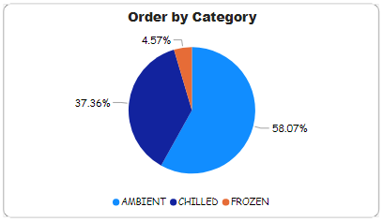
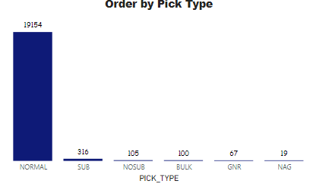
Product – Measures

Slide 9
Product -Syntax
Select PICK_TYPE, count(order_number) as No_of_Orders from Picking_Data
Group by PICK_TYPE
---Order Availability Unit
Select sum(ORDERED_QTY) As Ordered, Sum(QTY) as Delivered, Round(Sum(QTY)/sum(ordered_Qty),2) As Product_Availability_Rate from Picking_Data
where PICKED_UNIT_OF_MEASURE = 'each’
-------Order Availability Gram
Select sum(ORDERED_QTY) As Ordered, Sum(QTY) as Delivered, Round(Sum(QTY)/sum(ordered_Qty),2) from Picking_Data
where UNIT_OF_MEASURE = 'Gram’

Slide 10



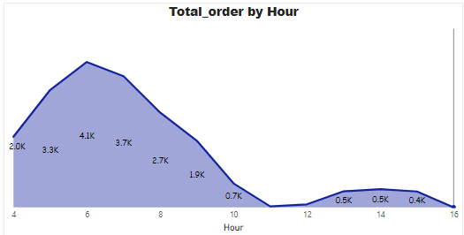
Customer – Measures

Slide 11
Customer - Syntax
---Include Hours column
---Create an hour column
ALTER TABLE Picking_Data
Add Order_Hour INT;
extract Hours from time
Update Picking_Data
SET Order_Hour = left(Event_time2, 2) from Picking_Data
--Orders by hours of the day
Select Order_hour, count(order_number) as Number_of_orders from picking_Data
group by Order_hour
order by order_hour
Average Order per customer
Select Count(order_number)/count(distinct order_number) as Average_order_per_Customer from Picking_Data
--Average unit per Transaction =
Select Round(sum(QTY)/count(order_number),0) as Transact_Per_Unit From Picking_Data
Where UNIT_OF_MEASURE = 'each’
----Average unit per Transaction
Select round(sum(QTY)/count(order_number),0) as Transact_Per_Gram From Picking_Data
Where UNIT_OF_MEASURE = 'gram’

Slide 12
Other Performance Measure to
Revenue Per Transaction
Conversion rate
Delivery cost per Transaction
Order Accuracy rate
Rate of Return
Average Delivery time
Percentage of sales lost to out-of-stock products.
Undamaged delivery rate
Net Promoter Score

Slide 13
Observations
----- POSSIBE DATA ERROR
Select count(PICKED_UNIT_OF_MEASURE) from Picking_Data
where PICKED_UNIT_OF_MEASURE <> UNIT_OF_MEASURE

Slide 14


Slide 15
Customer

